Slide 1
Bio& 242:
Unit 2 / Lab 1

Slide 2
Histology Slides for the Urinary System
Slides are presented in order of magnification
As you view the following slides make sure you can accomplish these goals:
Can you identify the organ or duct from which the tissue sample was taken?
Can you identify the specific structures or layers indicated by the numbered arrows or brackets?
At the end of a sequence, you will find the answers to the above for each organ or duct.

Slide 3
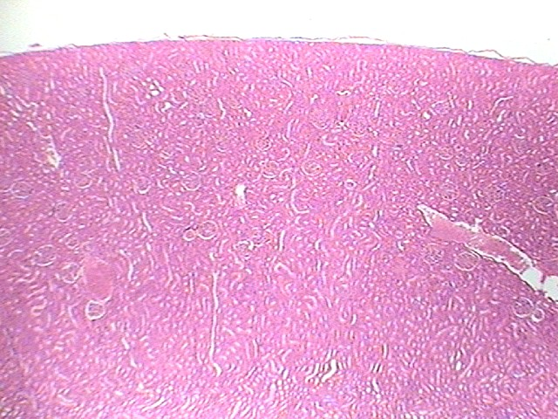
1
3
2
Organ? 40X

Slide 4
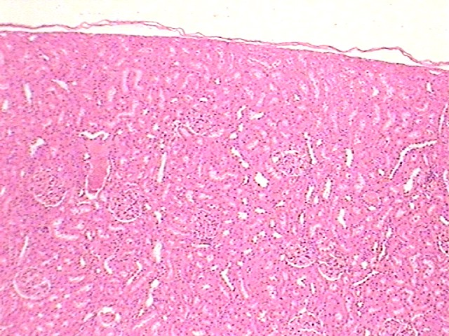
1
3
2
Organ and layer? 100X

Slide 5
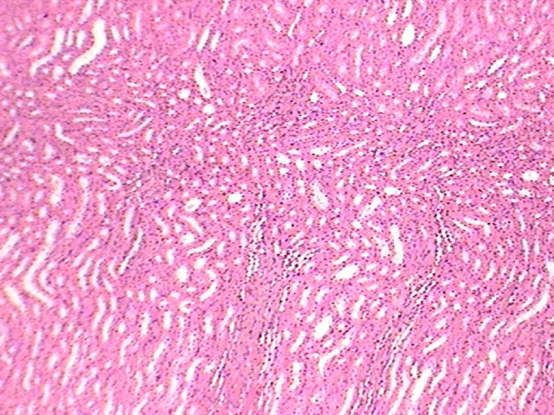
3
1
2
4
Organ and layers? 100X

Slide 6
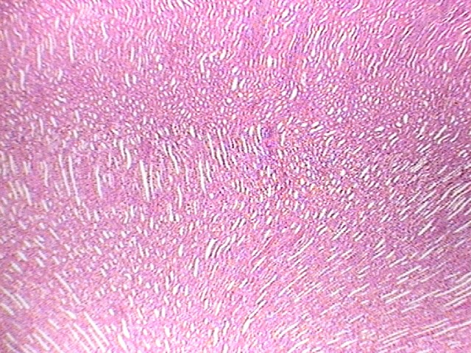
1
2
Organ and layer? 40X

Slide 7
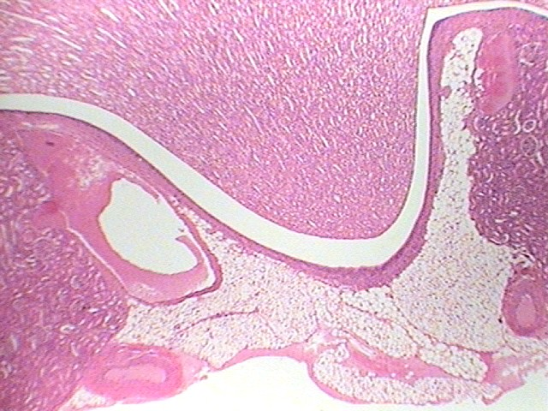
1
5
3
2
4
3
Organ and layer? 40X

Slide 8
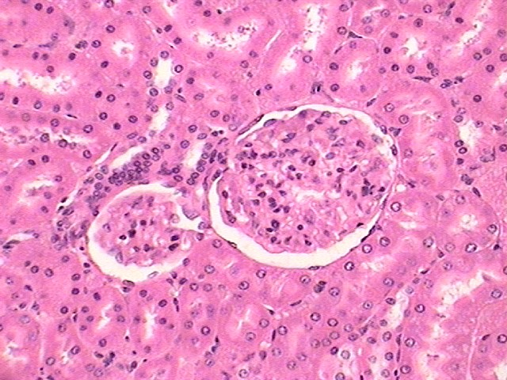
7
8
3
2
6
5
4
1
Organ and layer? 400X

Slide 9
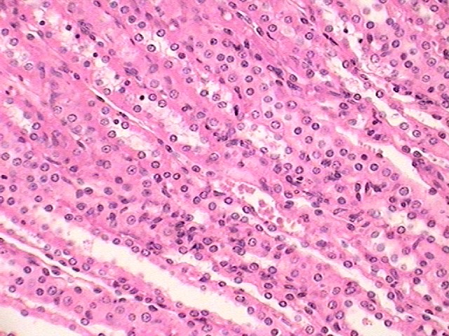
1
2
Organ and layer? 400X

Slide 10
Tissue from Kidney slides 2-8
Slide # 2: Cortex of the Kidney (40X)
1. Renal Capsule
2. Renal Corpuscle with Bowman’s Capsule
3. Cortex of the Kidney
Slide # 3: Cortex of the Kidney (100X)
1. Renal Capsule
2. Renal Corpuscle with Bowman’s Capsule
3. X-section through a Proximal or Distal Convoluted Tubule

Slide 11
Tissue from Kidney slides 2-8
Slide # 4: interface of Cortex and Medulla of the Kidney (100X)
1. Renal Cortex
2. Renal Medulla
3. X-section through a Proximal or Distal Convoluted Tubule
4. Longitudinal section through a thick portion of the Loop of Henle or collecting duct
Slide # 5: Medulla of the Kidney (40X)
1. Longitudinal section through a thick portion of the Loop of Henle or collecting duct
2. Longitudinal section through a collecting duct

Slide 12
Tissue from Kidney slides 2-8
Slide # 6: Medulla of the Kidney and Minor Calyx (40X)
1. Renal Papilla
2. Wall of the Minor Calyx demonstrating transitional epithelium
3. Areas of Renal Cortex with Renal capsules
4. Portion of the Renal Sinus filled with Adipocytes
5. Papillary duct within the Renal Papilla

Slide 13
Tissue from Kidney slides 2-8
Slide # 7: Renal Cortex (400X)
1. Parietal Epithelium of Bowman’s Capsule
2. Capsular Space where filtrate collects
3. Nucleus of a podocyte
4. Glomerulus of a Renal Corpuscle
5. Juxtaglomerular cells of a Juxtaglomerular Apparatus
6. Macula Densa of a Juxtaglomerular Apparatus
7. X-section through a Proximal Convoluted Tubule (Note presence of Microvilli)
8. X-section through a Distal Convoluted Tubule

Slide 14
Tissue from Kidney slides 2-8
Slide # 8: Renal Medulla (400X)
1. Longitudinal section through a collecting duct (note the Cuboidal epithelium)
2. Longitudinal section through a thin Loop of Henle (note the Squamous epithelium)

Slide 15
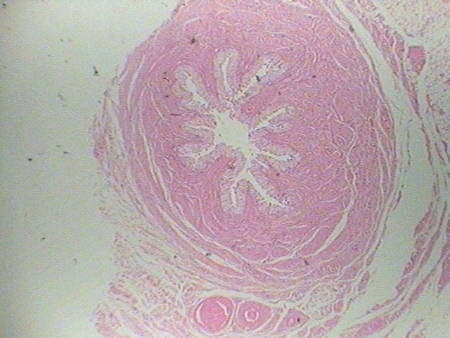
3
1
2
4
Duct? 40X

Slide 16
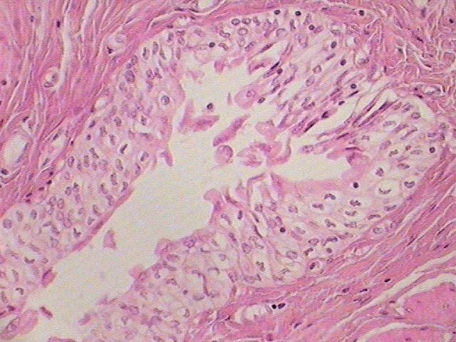
2
1
3
Duct? 400X

Slide 17
Tissue from Ureter slides 14-15
Slide # 14: X-Section of the Ureter (40X)
1. Lumen of the Ureter
2. Transitional Epithelium
3. Lamina Propria
4. Smooth Muscle
Slide # 15: X-Section of the Ureter (400X)
1. Lumen of the Ureter
2. Transitional Epithelium
3. Lamina Propria

Slide 18
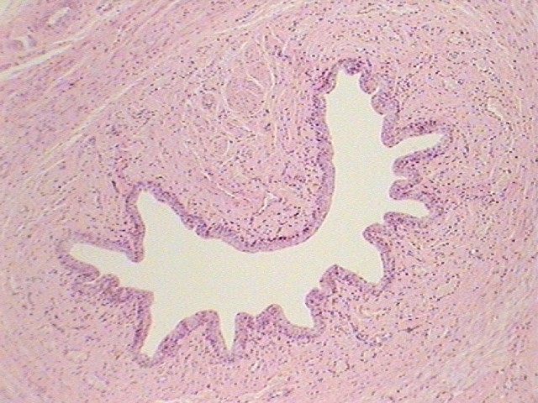
4
2
3
2
Duct? 100X

Slide 19
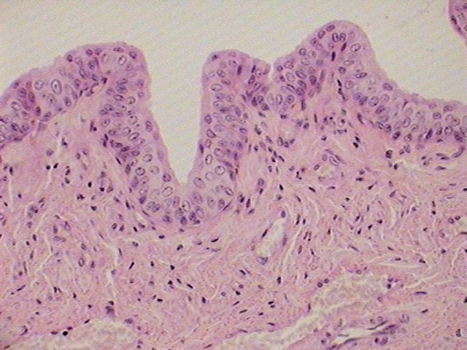
1
2
3
Duct? 400X

Slide 20
Tissue from Urethra slides 17-18
Slide # 17: X-Section of the Urethra (100X)
1. Lumen of the Urethra
2. Transitional Epithelium
3. Lamina Propria
4. Smooth Muscle
Slide # 18: X-Section of the Urethra (400X)
1. Lumen of the Urethra
2. Transitional Epithelium
3. Lamina Propria

Slide 21
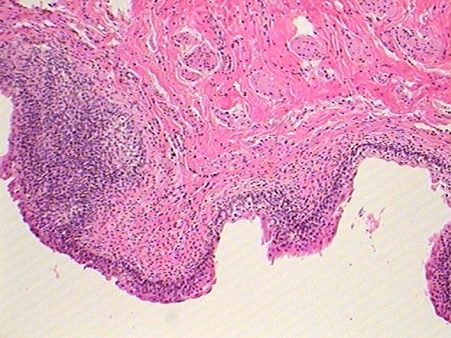
4
3
2
1
Organ? 40X

Slide 22
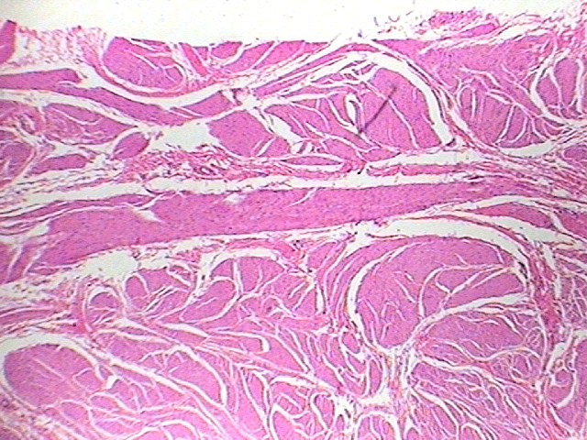
3
2
1
Organ? 100X

Slide 23
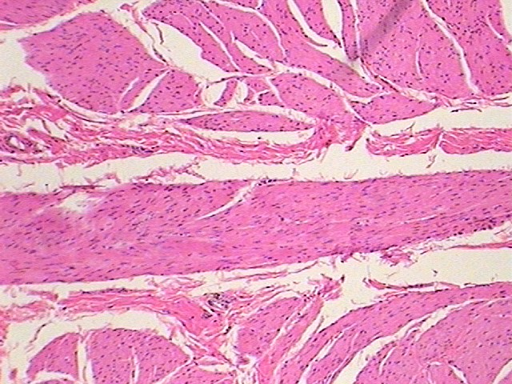
1
2
1
Organ? 400X

Slide 24
Tissue from Urinary Bladder slides 20-22
Slide # 20: X-Section of the Urinary Bladder (40X)
1. Lumen of the Urinary Bladder
2. Transitional Epithelium
3. Lamina Propria
4. Submocosa
Slide # 21: X-Section of the Urinary Bladder Muscularis layer (Detrusor muscle) (100X)
1. Inner Longitudinal smooth muscle layer
2. Circular smooth muscle layer
3. Outer Longitudinal smooth muscle layer

Slide 25
Tissue from Urinary Bladder slides 20-22
Slide # 21: X-Section of the Urinary Bladder Muscularis layer (Detrusor muscle) (400X)
1. Inner Longitudinal smooth muscle layer
2. Circular smooth muscle layer
3. Outer Longitudinal smooth muscle layer

